Slide 1

Outcome Measure Harmonization and Data Infrastructure for Patient Centered Outcomes Research in Depression
Proposed Draft Implementation Guide

Slide 2
Funding
This work is supported by the Office of the Secretary Patient-Centered Outcomes Research Trust Fund under Interagency Agreement 18-596R-18 through Agency for Healthcare Research and Quality contract no. 75Q80119C00005.
2

Slide 3
Background & Rationale
3

Slide 4

Outcome Measures Framework (OMF)
Goal: Common, conceptual model for classifying the range of outcomes that are relevant to patients and providers across most conditions
Process: Stakeholder-driven (~400) process incorporating iterative rounds of review and revision across multiple condition areas
4

Slide 5
Outcome Measures Framework (OMF)
5

Slide 6
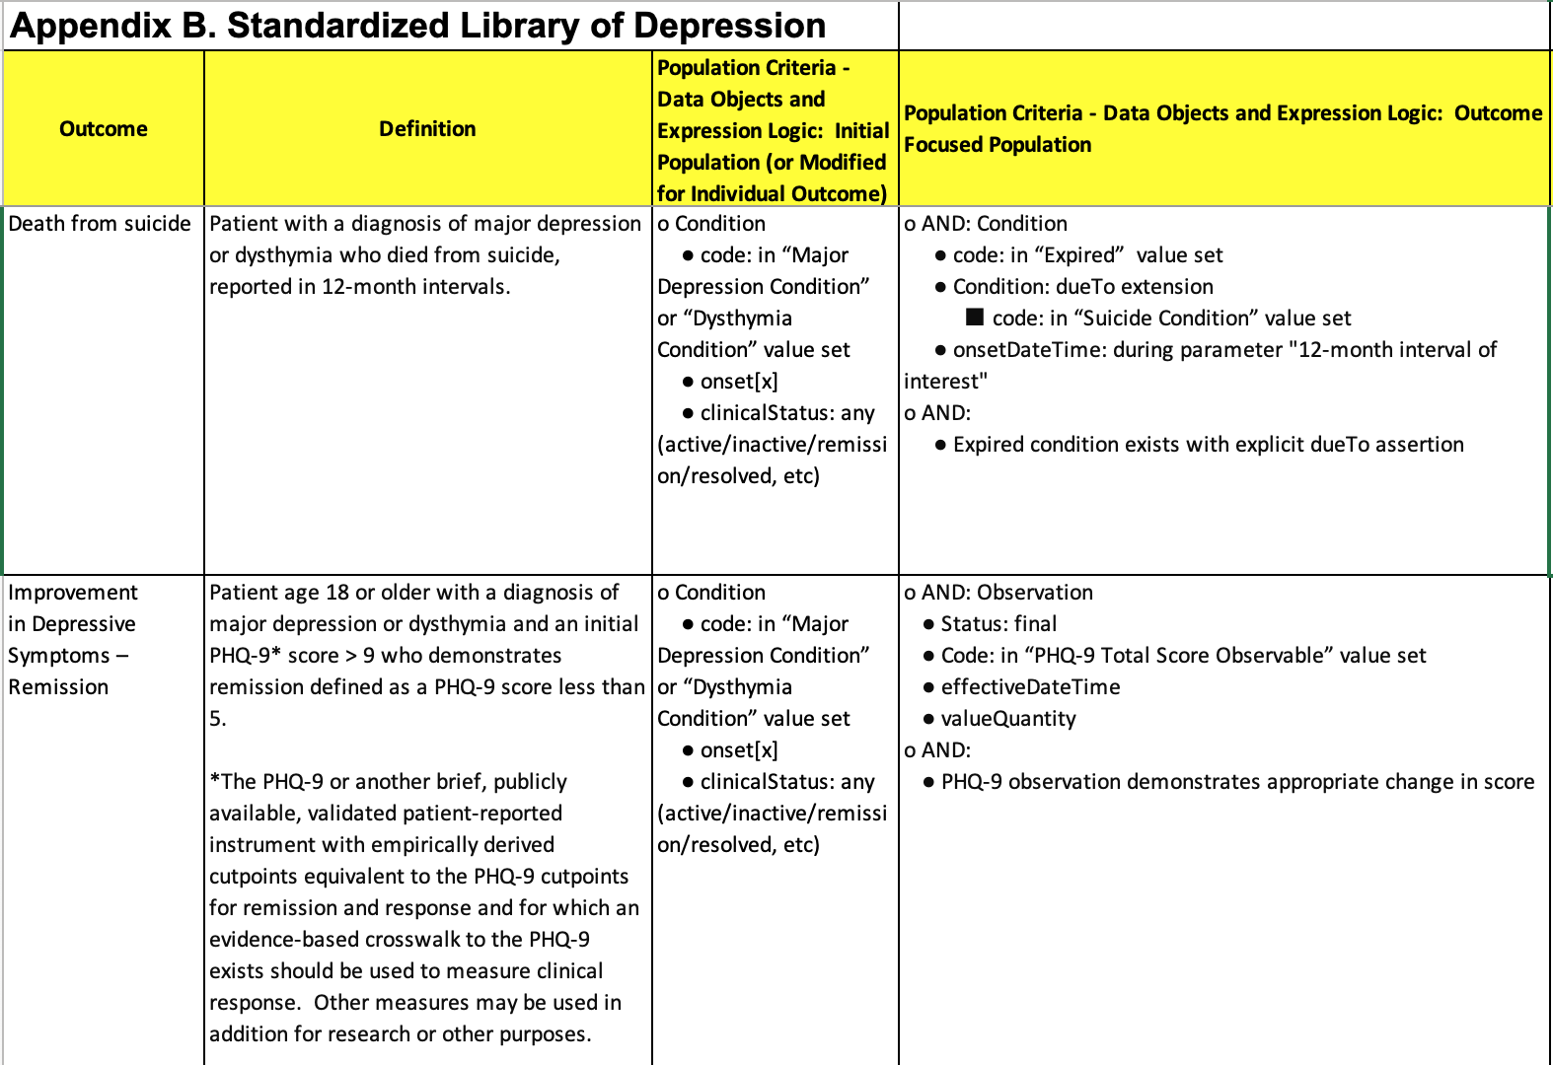
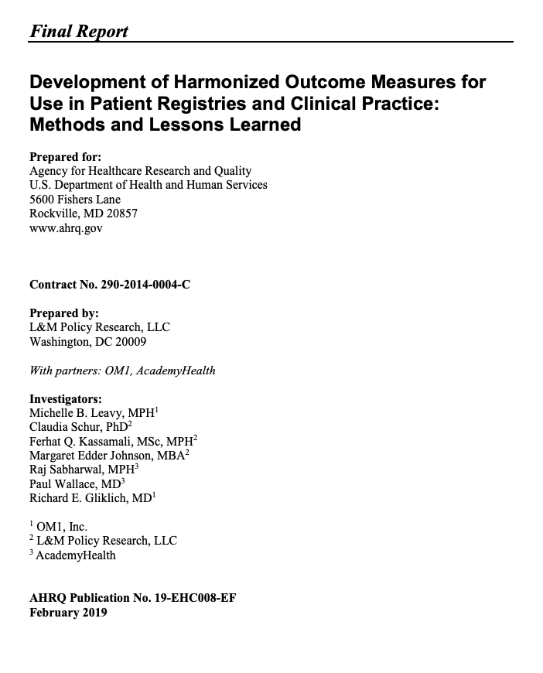
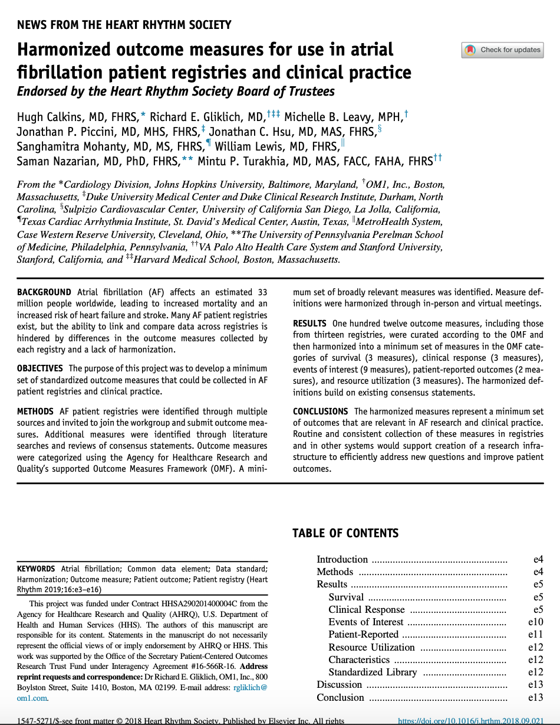

Harmonization using the OMF
Assess whether harmonized outcome measures can be developed for a sample set of 5 clinical areas:
Atrial fibrillation
Asthma
Depression
Lung cancer
Lumbar Spondylolisthesis
Translate narrative definitions into standardized terminologies to capture from EHRs and other systems
6

Slide 7
Potential Barriers
Stakeholders in the prior project expressed enthusiasm for the standardized depression outcome measures, but they identified several potential barriers:
How difficult will it be to extract the necessary data from different EHRs?
Is capture of the PROs on a regular basis too burdensome for patients and clinicians?
Are the measures useful for informing clinical decision-making and understanding and improving patient outcomes?
Will capture of the harmonized outcome measures improve the utility of the registry data for conduct patient-centered outcomes research?
7

Slide 8
Project Purpose and Objectives
Purpose: To demonstrate that capturing the harmonized outcome measures in the clinical workflow and submitting these data to different registries can improve clinical care, reduce the burden of registry participation, and increase the utility of registry data for research purposes.
Objectives:
Demonstrate that collection of the harmonized outcome measures is feasible, sustainable, and useful for clinicians participating in primary care and mental health patient registries.
Demonstrate that collection of the harmonized outcome measures is feasible, sustainable, and useful for clinicians in a health system setting.
Evaluate whether collection of the harmonized measures increased the utility of registry data for research purposes.
8

Slide 9
Project Overview
9

Slide 10
Depression Outcome Measures
All-cause mortality
Death from suicide
Improvement in Depressive Symptoms – Response
Improvement in Depressive Symptoms – Remission
Worsening in Depressive Symptoms – Recurrence
Adverse Events (related to depression treatment)
Suicide Ideation and Behavior
Depression-specific quality of life
Depression-related resource utilization
Work productivity
10

